Slide 1

HTML5 Multimedia Streaming
Niall Munro
EDINA
niall.munro@ed.ac.uk
@DevNiall
Notes:
NAME
WORK FOR
INFO ON JISC MEDIAHUB

Slide 2

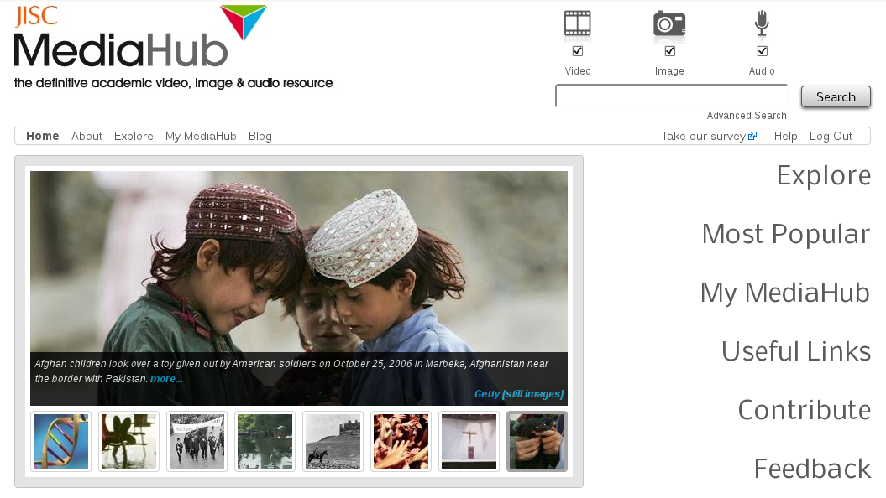
jiscmediahub.ac.uk
Notes:
Amalgamation of older services: EIG, NFO, FSOL
Getty Still Moving/still images
Films of Scotland
Associated Press (unedited 9/11 footage)
ITN Source
Gaumont British News

Slide 3





HTML5 Video Browser support
H.264 | 9+ | - | 3.0+ ² | 3.1+ | -
Theora | - | 3.5+ | 3.0+ | - | 10.5+
WebM | 9+ ¹ | 4.0+ | 6.0+ | ³ | 10.6+
WebM support via video element if codec is installed on the system
H.264 to be dropped in order to further open standards
WebM QuickTime plugin available
Notes:
Chrome Theora support buggy

Slide 4
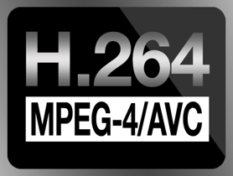


HTML5 media formats
File Format | Video Codec | Audio Codec
 | H.264 | AAC
 | Theora | Vorbis
 | VP8 | Vorbis
Notes:
AAC
Default audio compression for iPhone, iPod, iPad, iTunes and PlayStation 3
Manufacturers or developers of AAC codecs require a license, FFMPEG & FAAC (Free Advanced...) only distributable in source form only

Slide 5
Video compression formats
H.264 – Industry standard for video compression, most widely supported codec of the lot. Commercial users are required to pay royalties
Theora – originally put forward as the default video technology for HTML5 video, predecessor to WebM
WebM/VP8 – open sourced by Google after their acquisition of On2 Technologies
Notes:
h.264
H.264 is a patent encumbered video codec that has an almost ubiquitous presence in online video streaming services and has widespread adoption on mobile platforms. The codec was designed to meet a range of criteria such as the delivery of high quality video content at lower bitrates and being accessible across a wide variety of platforms.
MPEG-LA, nothing to do with MPEG standardisation organisation, administers the licenses for patents applying to this standard, as well as various other patent pools related to the MPEG standard.
Group includes: Apple, Hitachi, Microsoft, Mitsubishi, Panasonic, Samsung, Sharp, Sony, Toshiba etc.
Aggressive industry calls to find patent owners who may be infringed upon by Theora and WebM codecs.
Theora
Cortado, streaming Java apploet for Ogg Vorbis, Theora & Kate (speech?)
VP8
Google approached MPEG LA in order to allow royalty free use of H.264, offered to pay huge one off lump sum, they refused
In response Google bought On2 Technologies, creators of Theora & Vorbis, attempted to resolve lingering pattent issues before open sourcing the code

Slide 6
Audio compression formats
Advanced Audio Coding (AAC) – industry standard for audio compression, successor to MP3? Royalty free for distributors
Ogg Vorbis – open source audio codec developed by Xiph.org Foundation
Notes:
AAC
Default audio compression for iPhone, iPod, iPad, iTunes and PlayStation 3
Manufacturers or developers of AAC codecs require a license, FFMPEG & FAAC (Free Advanced...) only distributable in source form only

Slide 7
Encoding your media
FFmpeg – cross-platform multimedia framework, supports many codecs
ffmpeg2theora – tweaked fork of FFmpeg
qt-faststart – Tool for optimising MP4 files for streaming
flvtool2 – Tool for optimising FLV files for streaming
Notes:
RTSP
Real Time Streaming Protocol
Pseudo-streaming
Client requests offset specified in seconds via URL parameter.

Slide 8
Encoding your media (cont.)
Output 640x360 video at ~1024k:
MP4:
ffmpeg –i INPUT.avi –vpre libx264-baseline –s 640x360 –ac 128k –vb 896k TMP.mp4
qt-faststart TMP.mp4 OUTPUT.mp4
WebM:
ffmpeg –i INPUT.avi -vpre libvpx-360p –s 640x360 OUTPUT.webm
Theora:
ffmpeg2theora INPUT.avi –o OUTPUT.ogv –v 9
FLV:
ffmpeg -i INPUT.avi -s 640x360 -vb 896k -acodec libfaac –ab 128k –vb 896k OUTPUT.flv
flvtool2 –U OUTPUT.flv
Notes:
MP4
-g = keyframe every 10 seconds

Slide 9
Html Native Video Example
<video poster=“poster.png“ tabindex="0“ controls=“controls” preload="none">
<source src=“video.mp4“ type='video/mp4; codecs="avc1.4D401E, mp4a.40.2"' />
<source src=“video.webm“ type='video/webm; codecs="vp8.0, vorbis"' />
<source src=“video.ogv“ type='video/ogg; codecs="theora, vorbis"' />
</video>
Notes:
Poster
“Tabindex=0”, allows keyboard control of media element, space & arrows (left, right)
Controls, use native browser controls
Preload, if none specified 1st frame is loaded
Codecs, optional, formats don’t differ enough just now, supposed to prevent browser fetching the info from file header requests

Slide 10
Html Flash Video Example
<video id=“videoplayer” poster=“poster.png“ tabindex="0“ controls=“controls” preload="none">
<!-- INCLUDE SOURCES FROM PREVIOUS SLIDE -->
<object width="640" height=“360" type="application/x-shockwave-flash” data=“flowplayer-3.2.7.swf">
<param name="movie" value="flowplayer-3.2.7.swf" />
<param name="allowfullscreen" value="true" />
<param name="flashvars" value='config={"playlist":[“poster.png",
{"url": “video.mp4","autoPlay":false,"autoBuffering":true}]}' />
</object>
</video>
Notes:
MP4

Slide 11
Html Audio Example
<audio id="audioplayer" tabindex="0" controls="controls" preload="none">
<source src="audio.m4a" type="audio/mp4" />
<source src="autiod.oga" type="audio/ogg" />
<object width=“30" height=“360" type="application/x-shockwave-flash” data=“flowplayer-3.2.7.swf">
<param name="movie" value="flowplayer-3.2.7.swf" />
<param name="allowfullscreen" value="true" />
<param name="flashvars" value='config={"playlist":[“poster.png",
{"url": “audio.m4a","autoPlay":false,"autoBuffering":true}]}' />
</object>
</audio>
Notes:
MP4

Slide 12
HTML5 (Pseudo-)streaming
HTTP based delivery solution, no special control protocol required e.g. RTSP
Byte-range requests work out of the box on most web servers, same functionality is used to resume downloads
Seek points are calculated from the file header metadata where keyframes are mapped to byte offsets rather than time based offsets
Notes:
RTSP
Real Time Streaming Protocol
Pseudo-streaming
Client requests offset specified in seconds via URL parameter.
There are two methods of streaming being implemented in this section, "Byte-range" requests and the "H264 Streaming Module" for Apache. Both methods are known as "pseudo-streaming" as we are not using the time offset to seek the stream, rather the byte offset.
Byte-range serving
The good news is that "Byte-range" requests work out of the box on most web servers, this functionality is mainly used to provide partial content download support which is used when resuming downloads of files. This technique is a hack on that original functionality to provide pseudo-streaming of video files that have been encoded at a constant bitrate. The stream bitrate is used along with the play position to work the byte offset to serve, essentially providing seek capabilities in your stream.
This is all provided without the need to change any of the default Apache HTTP server configuration files.

Slide 13
Flash (Pseudo)-streaming
Flash pseudo-streaming enabled via server modules, YouTube uses this method to deliver their videos
Supporting clients requests playback offset via a URL parameter e.g. http://example.com/media/video.mp4?start=120
Notes:
RTSP
Real Time Streaming Protocol
Pseudo-streaming
Client requests offset specified in seconds via URL parameter.
There are two methods of streaming being implemented in this section, "Byte-range" requests and the "H264 Streaming Module" for Apache. Both methods are known as "pseudo-streaming" as we are not using the time offset to seek the stream, rather the byte offset.
Byte-range serving
The good news is that "Byte-range" requests work out of the box on most web servers, this functionality is mainly used to provide partial content download support which is used when resuming downloads of files. This technique is a hack on that original functionality to provide pseudo-streaming of video files that have been encoded at a constant bitrate. The stream bitrate is used along with the play position to work the byte offset to serve, essentially providing seek capabilities in your stream.
This is all provided without the need to change any of the default Apache HTTP server configuration files.

Slide 14
Flash (Pseudo)-streaming (Cont.)
Server reads keyframe metadata information from resource file header to determine the byte-range request
Server modules available for Apache HTTP, Lighthttpd & Nginx, IIS solutions available too
PHP script implementations are also available, resource heavy!
Supporting Flash players include Flowplayer & JW Player
Notes:
RTSP
Real Time Streaming Protocol
Pseudo-streaming
Client requests offset specified in seconds via URL parameter.

Slide 15
Flash (Pseudo)-streaming (Cont.)
H264 Streaming Module – includes support for virtual video clips & adaptive streaming http://h264.code-shop.com/trac
mod_flvx http://journal.paul.querna.org/articles/2006/07/11/mod_flvx/
Notes:
RTSP
Real Time Streaming Protocol
Pseudo-streaming
Client requests offset specified in seconds via URL parameter.

Slide 16
Apache Server configuration
LoadModule h264_streaming_module modules/mod_h264_streaming.so
AddHandler h264-streaming.extensions .mp4 .m4a
LoadModule flvx_module modules/mod_flvx.so
AddHandler flv-stream .flv
<!-- VIDEO MIMETYPES -->
AddType video/mp4 .mp4
AddType video/ogg .ogv
AddType video/webm .webm
<!-- AUDIO MIMETYPES -->
AddType audio/mp4 .m4a
AddType audio/ogg .oga
Notes:
H264 Streaming Module
This module is required in order to provide seek support in our video streams that are served to a client using the alternative Flash based player, specifically Flowplayer which supports this module via its own plugin. Versions of Flash earlier than 10.0 do not support byte-range requests so we need this module to serve up a "virtual" stream where the seek point is taken from a query parameter and served to the player as a new stream each time the video is seeked.
In order to download and install this module, please follow their instructions for Apache here.
After completing the previous instructions you should now be ready to serve up H.264 video streams to your clients.

Slide 17

Nginx – high performance HTTP server developed by Igor Sysoev
Publicly available since 2004
Event based architecture rather than traditional thread based architecture
Solves C10K problem
Supports MP4 (module) & FLV (native) pseudo-streaming
Notes:
Nginx
High performace, small memory footprint (~2.5Mb per 10k inactive HTTP connections)
Serves just over 11% of all domains including: WordPress, Github, SourceForge etc.
asynchronous event-driven approach
C10K problem
Software architecture becomes the bottleneck, spawning a new thread for each connection no longer scales.
Nginx

Slide 18
Example configuration file:
location /demo {
limit_rate 1500k;
limit_rate_after 500k;
alias /path/to/media;
location ~ \.flv$ {
flv;
}
location ~ \.mp4$ {
mp4;
}
location ~ \.m4a$ {
mp4;
}
}
Notes:
Nginx
High performace, small memory footprint (~2.5Mb per 10k inactive HTTP connections)
Serves just over 11% of all domains including: WordPress, Github, SourceForge etc.
asynchronous event-driven approach
C10K problem
Software architecture becomes the bottleneck, spawning a new thread for each connection no longer scales.
Nginx

Slide 19
Securing Media with X-Accel-Redirect:
location /protected/ { #/protected, only available to internal redirects
internal;
root /hidden/path/to/media/;
}
PHP example:
$file = $_GET[‘file’];
if( authenticated )
header("X-Accel-Redirect: /protected/" . $file); //serves /hidden/path/to/media/$file
else
print ‘<p>Cheeky unauthenticated fool!</p>’;
Notes:
As you can see, we have additional “internal” location /files there. This keyword “internal” allow us to have some locations, that will be available for user only in internal redirects and X-Accel-Redirect responses from backend scripts. So, we can use simple PHP script or Rails code on backend server to implement controlled downloads that will support Ranges header and all other features supported by direct static downloads from nginx servers.

Slide 20
HTML5 Media JavaScript API
var v = document.getElementsByTagName("video")[0];
v.play();
v.pause();
v.currentTime = 120; //seek to 120 seconds
//Seek attempt before media initialisation
if( v.readyState > = v.HAVE_FUTURE_DATA ) {
v.currentTime = 120;
} else {
v.play();
v.onloadedmetadata = function() { //event
v.currentTime = 120;
}
}
Notes:
MP4

Slide 21
HTML5 Multimedia Streaming
Niall Munro
EDINA
niall.munro@ed.ac.uk
@DevNiall

